Slide 1
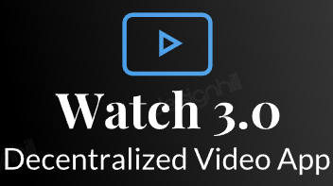
Decentralized Video Streaming App
(WATCH 3.0)
Name | UID | Section
Aman Kumar | 20BCS3977 | 20BDA KRG-2
Anurag Mishra | 20BCS3691 | 20BIS2-B
Rishabh Sharma | 20BCS3694 | 20BIS2-B

Slide 2
PROBLEM STATEMENT
The most popular website for watching videos online right now is YouTube. Additionally, it is the second-most used Google-based search engine worldwide. Nevertheless, despite being widely used, YouTube has a few drawbacks. The centralised nature (i.e. single organization governing the data flow), of the platform is largely to blame for these problems.
The databases YouTube currently use, can give anyone administrative accounts or role-based user accounts that can allow a hacker to gain full control of a database simply by hacking the right account.

Slide 3
PROPOSED SOLUTION
Blockchain, the underlying technology of the digital currency bitcoin, is a decentralised public ledger of transactions that is not owned or controlled by any one entity. Instead, the full blockchain is accessible to all users, and each transfer of money from one account to another is documented using mathematical methods taken from cryptography in a way that is secure and verifiable. It is thought that the blockchain is practically tamper-proof because there are copies of it all across the world. This application of video streaming, works on blockchain, which allow user to upload their content as NFT, As the problem in Youtube ads is one of the problem but in decentralized application, it helps user to owner of it all of the content no other can make any changes. A better data security and privacy to all the user, because of it’s unique hashing algorithm.

Slide 4
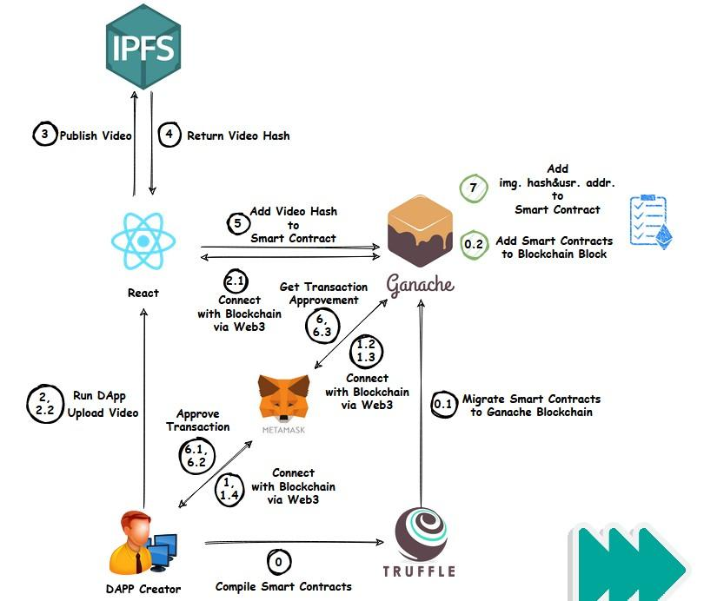
Software Architecture

Slide 5
PROJECT SCOPE
Blockchain is the leading technology for creating a decentralized system.
Using Blockchain, we can establish peer to peer connections, with no central authority having control over it.
Every video can be used as NFT, which has its unique hash in blocks.
In traditional YouTube app, the major source of revenue is by displaying in-video and banner ads. But in our app, revenue generation can be implemented using blockchain, which further makes the experience convenient.
A user can mint their videos directly and convert it to NFT.

Slide 6
TECHNOLOGY STACK
Solana: It is a public blockchain platform with smart contract functionality. Its native cryptocurrency is SOL.
Ethereum: It is a decentralized, open-source blockchain with smart contract functionality. Ether is the native cryptocurrency of the platform.
Rust: Rust is a multi-paradigm, general-purpose programming language. Rust emphasizes performance, type safety, and concurrency.
JavaScript / Flutter: Both languages can be used to make a user-friendly, responsive web front-end.
IPFS: The Interplanetary File System (IPFS) is a distributed file storage protocol that allows computers all over the globe to store and serve files as part of a giant peer-to-peer network. Here can be used as Database.
Infura: Infura is a Web3 backend and Infrastructure-as-a-Service (IaaS) provider that offers a range of services and tools for blockchain developers. This includes the Infura API (Application Programming Interface) suite.
Ganache: It is used for setting up a personal Ethereum Blockchain for testing your Solidity contracts.
Remix IDE: Remix IDE allows developing, deploying and administering smart contracts for Ethereum like blockchains.
Git: It is used for version control to make the work-flow easier and collabration with other members smooth.

Slide 7
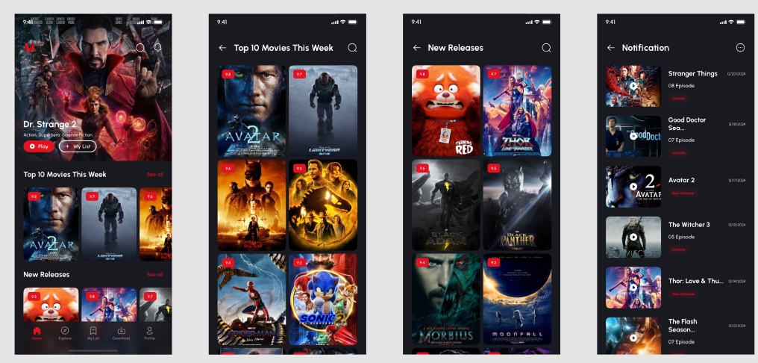
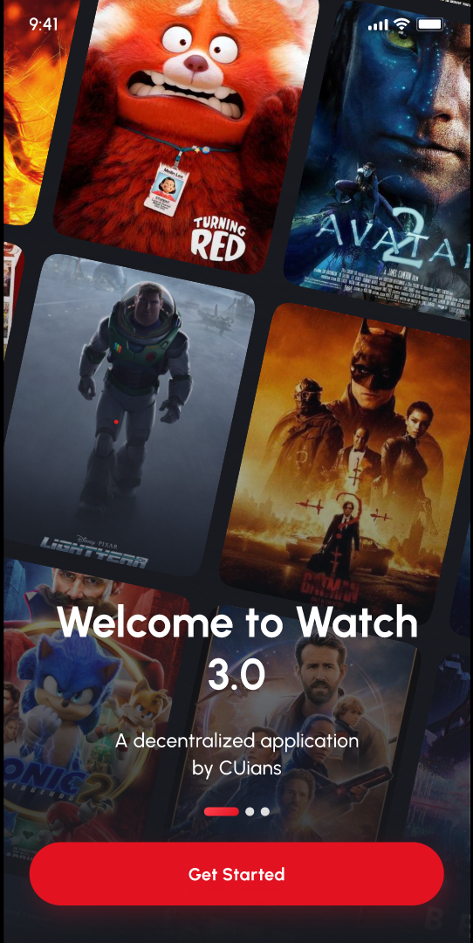
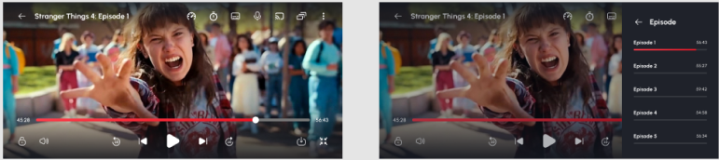
UI/UX Designs

Slide 8
Thankyou

